Slide 1

Apex Institute of Technology
Department of Computer Science & Engineering
Computer Networks
(CST-335)
Dr.Monica Luthra
E9836
Assistant Professor
CSE(AIT), CU
DISCOVER . LEARN . EMPOWER

Slide 2

Course Objectives
CO Number | Title
CO1 | Describe the important networking concepts
CO2 | Understand concept of network reference models and protocols
CO3 | Apply the concepts of routing algorithms on various networks
CO4 | Identify mechanism to handle traffic and control on congestion
CO5 | Identify and understand connection establishment techniques and features

Slide 3

Course Outcomes
After this course student will be able to:
To bring together several key of Computer network design and architecture
To Familiarize the student with the basic taxonomy and terminology of the computer networking area.
To Allow the student to gain expertise in some specific areas of networking such as the design and maintenance of individual networks.

Slide 4
Table of Contents
Congestion Control Introduction and Prevention Policies.
Congestion Control datagram in subnet

Slide 5
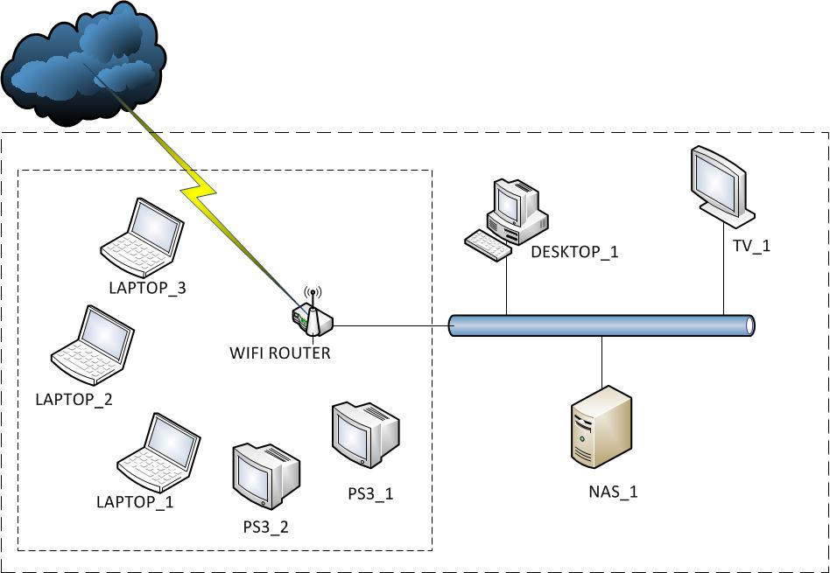
Congestion
Simple Definition – Analysis on Allowed number of packet vs Actual number of present packets
Technical Definition – When too many packets are present in Network then it is called as congestion
Congested Network – Is when traffic occurs very high then intermediate nodes start losing Packets
Several Factors of Congestion
QUEUE
Insufficient Memory
Image Source :https://www.geeksforgeeks.org/congestion-control-in-computer-networks/

Slide 6
Congestion
Nagle’s View
TTL of a Packet gets expire when there is infinite memory resulting in longer queue
Slow Processor
Bookkeeping Tasks
Low Bandwidths
Frequent Mismatch between parts of system.

Slide 7
Congestion Control vs Flow Control
Congestion Control
Is all about making subnet capable enough for carrying required traffic
Flow Control
Related to P2P traffic between Sender and Receiver
Make sure that sender does not transmit data faster than capacity of Receiver to absorb it
Sliding Window Protocol
Example Congestion Control
Two or more same type system are trying to send more than 100kb data using 100 kbps transmission media
Example Flow Control
Transmission of data from Super computer to Normal Computer on fiber optics media of 1gigabit/Sec speed

Slide 8
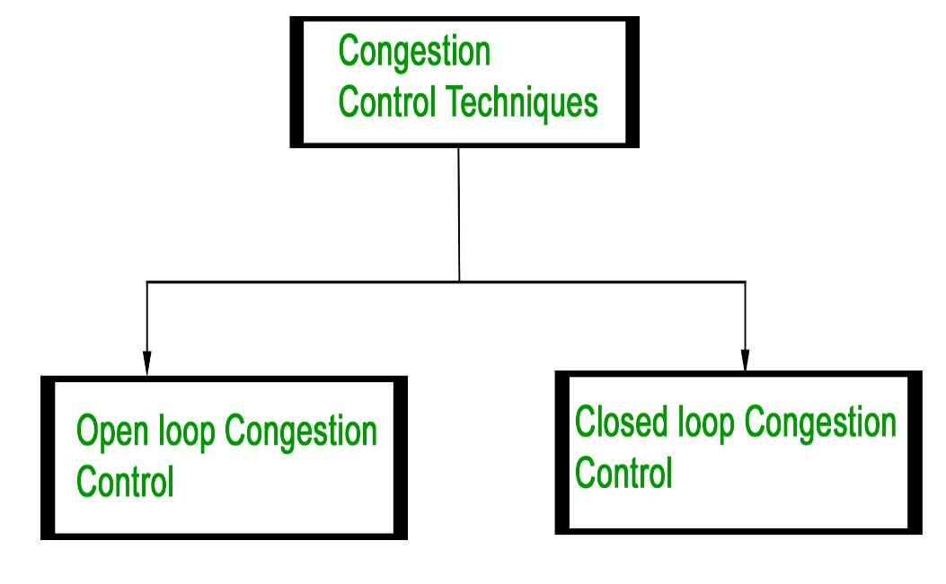
Principles of Congestion Control
General Principles of Congestion Control
Monitor the System
Passing of Information to places where action can be taken
Adjust System operation to correct Problem
Types of Correction
Open Loop correction
Closed Loop Correction – Works on Feedback
Image Source :https://www.geeksforgeeks.org/congestion-control-in-computer-networks/

Slide 9
Principles of Congestion Control
Monitoring of System – Metric Used where rising number indicates increasing congestion
%age of discarded Packets due to lack of Buffer space
Average Queue Length
Number of packets timed out
Average Delay
Information Passing
Transferring congestion from the point it got detected to the point where something can be done
System Adjustments

Slide 10
OPEN LOOP CONGESTION CONTROL
Policies adopted by open loop congestion control –
Retransmission Policy : It is the policy in which retransmission of the packets are taken care. If the sender feels that a sent packet is lost or corrupted, the packet needs to be retransmitted. This transmission may increase the congestion in the network. To prevent congestion, retransmission timers must be designed to prevent congestion and also able to optimize efficiency.
Window Policy :
To implement ,selective reject window method is used for congestion control. Selective Reject method is preferred when timers for a packet times out, several packets are resent, although some may have arraived safely aat the reciever.
thus this duplication may make congeston to occur.

Slide 11
OPEN LOOP CONGESTION CONTROL
Discarding Policy : A good discarding policy adopted by the routers is that the routers may prevent congestion and at the same time partially discards the corrupted or less sensitive package and also able to maintain the quality of a message. In case of audio file transmission, routers can discard less sensitive packets to prevent congestion and also maintain the quality of the audio file.
Acknowledgment Policy : Since acknowledgement are also the part of the load in network, the acknowledgment policy imposed by the receiver may also affect congestion. Several approaches can be used to prevent congestion related to acknowledgment. The receiver should send acknowledgement for N packets rather than sending acknowledgement for a single packet. The receiver should send a acknowledgment only if it has to sent a packet or a timer expires

Slide 12
OPEN LOOP CONGESTION CONTROL
Admission Policy : In admission policy a mechanism should be used to prevent congestion. Switches in a flow should first check the resource requirement of a network flow before transmitting it further. If there is a chance of a congestion or there is a congestion in the network, router should deny establishing a virtual network connection to prevent further congestion.
All the above policies are adopted to prevent congestion before it happens in the network.

Slide 13
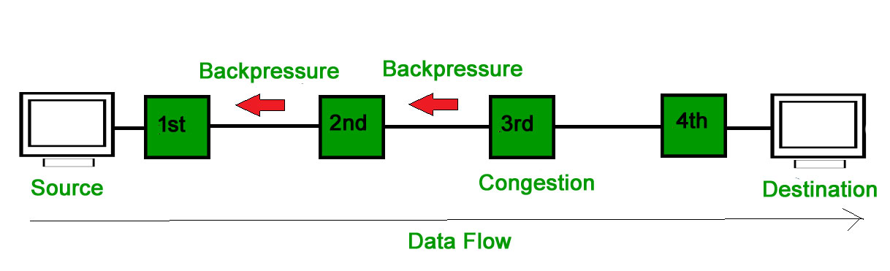
Closed Loop Congestion Control
Closed loop congestion control technique is used to treat or alleviate congestion after it happens. Several techniques are used by different protocols; some of them are:
Backpressure : Backpressure is a technique in which a congested node stop receiving packet from upstream node. This may cause the upstream node or nodes to become congested and rejects receiving data from above nodes. Backpressure is a node-to-node congestion control technique that propagate in the opposite direction of data flow. The backpressure technique can be applied only to virtual circuit where each node has information of its above upstream node.
In diagram the 3rd node is congested and stops receiving packets as a result 2nd node may be get congested due to slowing down of the output data flow. Similarly 1st node may get congested and informs the source to slow down

Slide 14
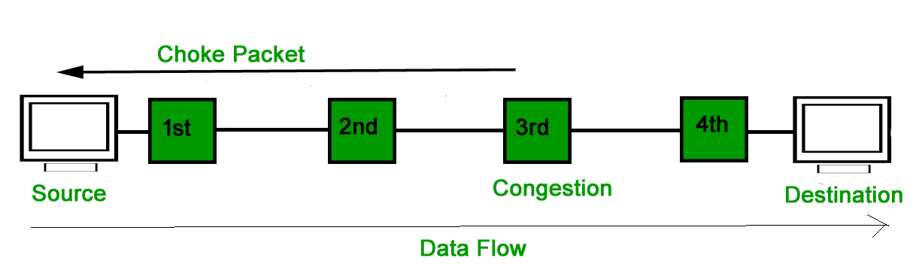
Closed Loop Congestion Control
Choke Packet Technique : Choke packet technique is applicable to both virtual networks as well as datagram subnets. A choke packet is a packet sent by a node to the source to inform it of congestion. Each router monitor its resources and the utilization at each of its output lines. whenever the resource utilization exceeds the threshold value which is set by the administrator, the router directly sends a choke packet to the source giving it a feedback to reduce the traffic. The intermediate nodes through which the packets has traveled are not warned about congestion.

Slide 15
Closed Loop Congestion Control
Implicit Signaling : In implicit signaling, there is no communication between the congested nodes and the source. The source guesses that there is congestion in a network. For example when sender sends several packets and there is no acknowledgment for a while, one assumption is that there is a congestion
Explicit Signaling : In explicit signaling, if a node experiences congestion it can explicitly sends a packet to the source or destination to inform about congestion. The difference between choke packet and explicit signaling is that the signal is included in the packets that carry data rather than creating different packet as in case of choke packet technique. Explicit signaling can occur in either forward or backward direction.
Forward Signaling : In forward signaling signal is sent in the direction of the congestion. The destination is warned about congestion. The reciever in this case adopt policies to prevent further congestion.
Backward Signaling : In backward signaling signal is sent in the opposite direction of the congestion. The source is warned about congestion and it needs to slow down.

Slide 16
Congestion Control in Virtual Circuit Subnet
Admission Control Technique
Explanation : Idea is when congestion occurs then no more Virtual Circuits will be developed, until previous congestion gets resolved
It means transport layer will be at hold situation
Alternative Approach
Explanation : It allows creation of new Virtual Circuit
But Virtual Circuit should be handled carefully at congested area

Slide 17
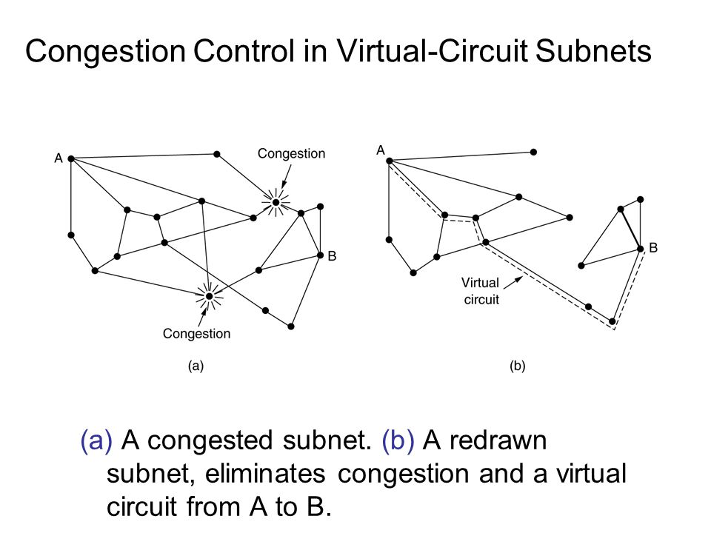
Congestion Control in Virtual Circuit Subnet
Another Strategy
Explanation : Is to set up Virtual Circuit with some negotiations
Shape and Volume of Traffic
QOS
Reserved Resources for New Virtual Circuits
Disadvantage is wastage of resources

Slide 18
Congestion Control in Datagram Subnet
The Warning Bit
Choke Packets
Hop by Hop Choke Packets
Image Source :https://www.geeksforgeeks.org/congestion-control-in-computer-networks/

Slide 19
CONGESTION CONTROL IN DATAGRAM SUBNETS
Each router can easily monitor the utilisation of its output lines and other resources.Each newly arriving packet is checked to see if its output line is in warning state.If it is in warning state ,some action is taken.They are:
The warning bit
Choke packets
THE WARNING BIT
The old DECENT architecture signals the warning state by setting a special bit in the packet's header.
When the packet arrived at its destination, the transport entity copied the bit into the next acknowledgement sent back to the source. The source then cut back on traffic.
As long as the router is in the warning state,it is continued to be in the warning bit.
As long as the warning bits continued to flow in ,the source continued to decrease its transmission rate.

Slide 20
CONGESTION CONTROL IN DATAGRAM SUBNETS
Choke Packets
A specialized packet that is used for flow control along a network.
The router sends a choke packet back to the source host,giving it the destination found in the packet.
When the source gets the choke packet,it is required to reduce the traffic sent to the specified destination by X percent.
If more packets arrives at the same destination ,the host ignores some choke packets for a fixed time interval.
After that period has expired,the host listens for more choke packets for another interval.
If no packets arrive during the listening period,the host may increase the flow again.
Hosts can reduce traffic by adjusting their policy parameters.
Routers can maintain threshold,depending on them the choke packet can contain a mild warning,a stern warning, or an ultimatum.

Slide 21
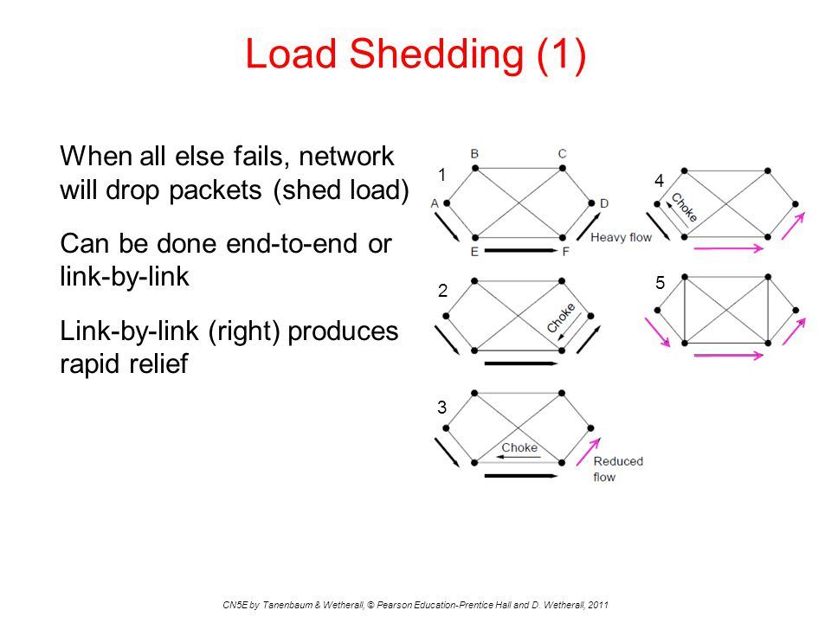
Congestion Control (Continue)
Load Shedding
Random Early Detection (RED)
Jitter Control
Image Source : https://slideplayer.com/slide/3953396/

Slide 22
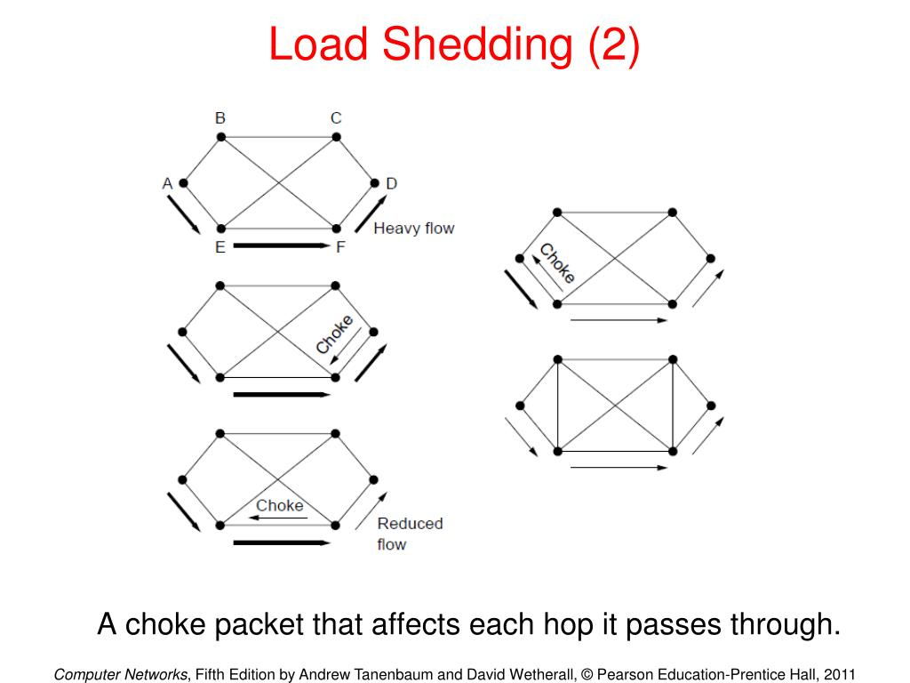
Congestion Control (Continue)
Load Shedding
Image Source : https://slideplayer.com/slide/3953396/

Slide 23
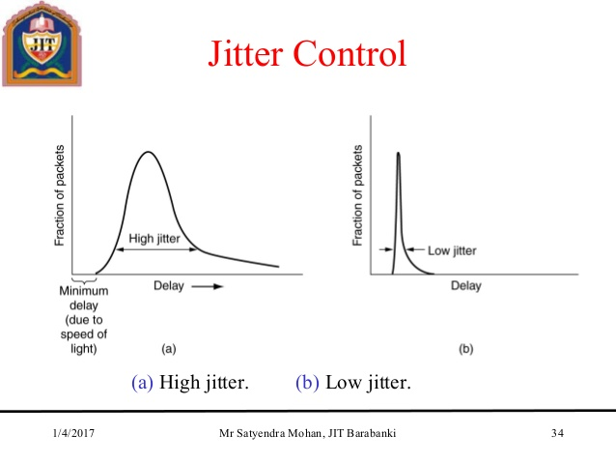
Congestion Control (Continue)
Jitter Control
Image Source : https://www.slideshare.net/SATYENDRA_MOHAN/the-network-layer-in-cn

Slide 24
Quality of Service
Requirement
Techniques of achieving Load QOS
Leaky Bucket Algorithm
Token Bucket Algorithms

Slide 25

Key Points
Introduction to Congestion Control
Congestion Control Prevention Policies
Congestion Control Methods
Congestion Datagram In Subnet

Slide 26
FAQ
What are the two basic mechanisms of congestion control?
In what way token bucket algorithm is superior to leaky bucket algorithm?
How congestion control is performed by leaky bucket algorithm?
What is choke packet? How is it used for congestion control?

Slide 27
APPLICATIONS
Different Dynamic Routing Protocols Like
RIP
IGRP
EIGRP
OSPF
BGP
Static Routing Method
Congestion Control
Sliding Window Protocol
Bottlenecking
Network total Overhead
Network Overhead calculations

Slide 28
References
http://datagram123.blogspot.com/2017/02/congestion-control-in-datagram-subnets.html
https://www.geeksforgeeks.org/congestion-control-in-computer-networks/

Slide 29
THANK YOU
For queries
Email: monica.e9836@cumail.com

